Slide 1
Advanced New Hardware Optimized for Policy Enforcement Arun Thomas arun@draper.com Chris Casinghino ccasinghino@draper.com Arch Owen aowen@draper.com Jeff Opper jopper@draper.com

Slide 2
HOPE Innovations
A single, unified hardware-software security architecture can cover all 7 SSITH CWE vulnerability classes
Every word has metadata. Every instruction is checked.
Supports flexible security micropolicies
Policies are defined in software, not baked into hardware
Formal specification and verification gives precise guarantees of security and high assurance of correctness
PPASS Workbench aids designer in customizing security architectures/policies for PPASS requirements

Slide 3
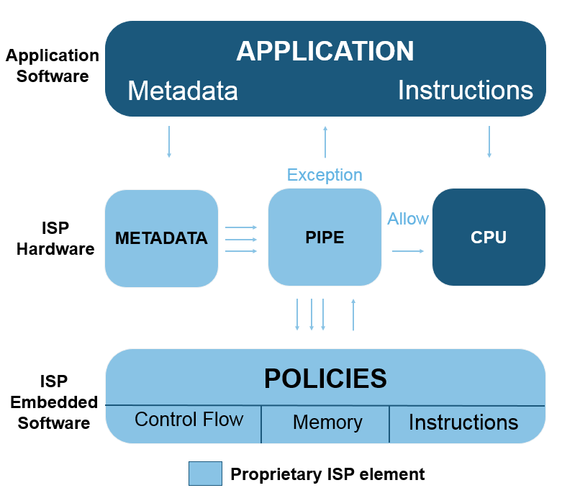
Draper HOPE
HOPE adds 3 elements to an existing architecture to create defensible hardware
Programmable Metadata Tags
Each data word has a programmable tag.
Cannot be modified by user application.
Micropolicies
Define security, safety, or correctness requirements.
Processor Interlocks for Policy Enforcement (PIPE)
Unassailable hardware interlock enforces policies.
Runs parallel to application processor.
HOPE
Hardware
HOPE
Embedded
Software
HOPE element

Slide 4
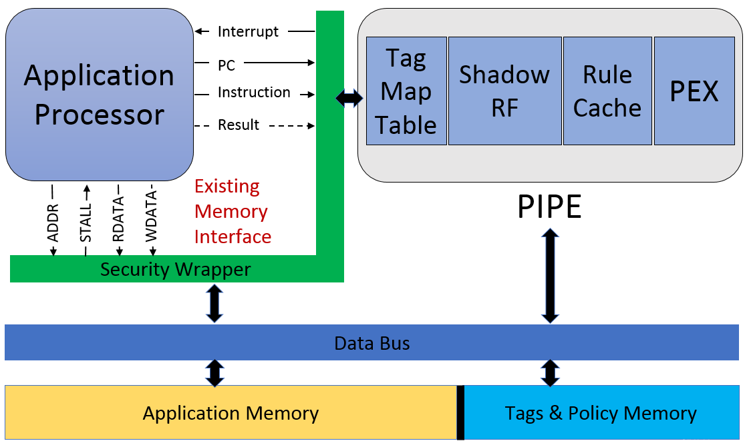
PIPE Diagram
PIPE: Processor Interlocks for Policy Enforcement

Slide 5
Metadata Tags
Each memory word and register has a programmable metadata tag.
At every instruction, tags for the relevant memory and registers are passed to the PIPE.
Application cannot directly create or modify tags.
Tags can be pointers to arbitrary data structure, enabling complex policies.
Instruction, user data, etc.
metadata tag | data payload
Example metadata:
Provenance
Access rights
Object type
Executable?
Legal branch target?
Buffer bounds

Slide 6
Micropolicies
Example Policies
Heap Safety
Stack Safety
Control-flow Integrity
Compartmentalization
Information Flow Control
Domain-specific policies
Policies define what instructions are allowed and how metadata is updated.
Policies are written in a domain-specific rule language.
PIPE sends metadata tags to policies running on the policy execution core.
Policies check metadata against installed rules and reject bad behavior.

